Slide 1

Green Brew Bros
Alex, Dustin, Lewis, Meredith

Slide 2
Overview
Client:
Nova Scotia microbrewery
Young business
Craft beers
Eco-friendly
Involved in trade shows
Target audience:
Environmentally-conscious millennials
Potential sponsors

Slide 3
Client Expectations
Purpose
Establish brand
Attract customers and sponsors
Objectives
Promote trade shows
Present mission
Showcase products
Invite visitors to contact

Slide 4
Planning

Slide 5
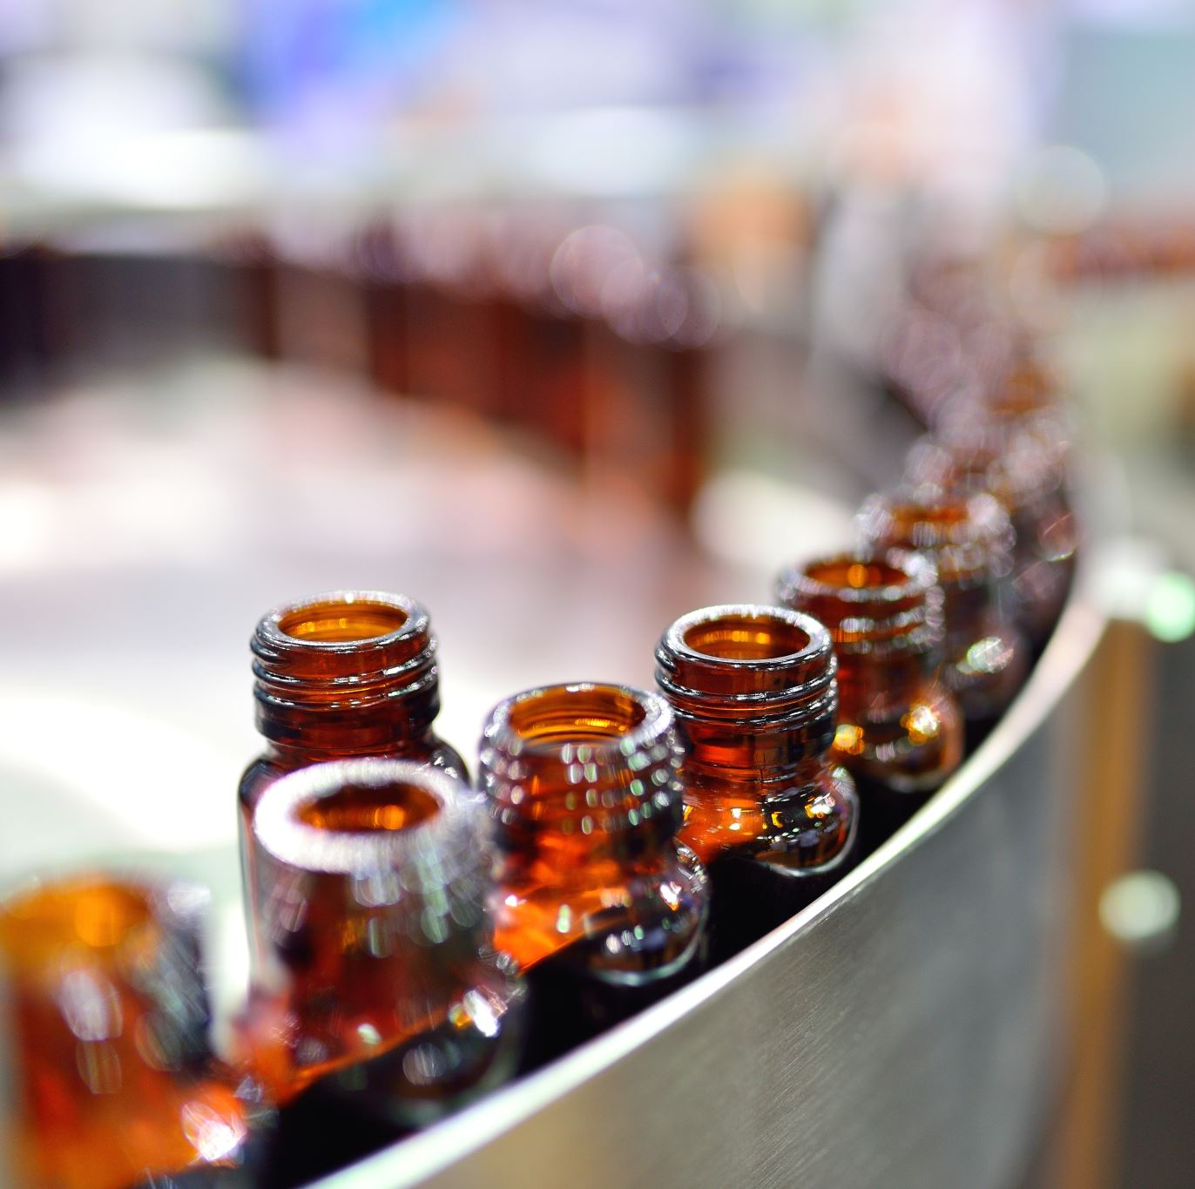
Content
Home
About Us
Events
Our Beers
Our Brewery
Contact US

Slide 6
Wireframes
Desktop

Slide 7
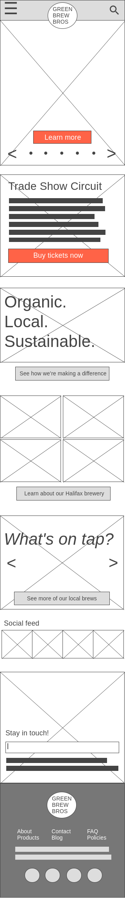
Wireframes
Mobile

Slide 8
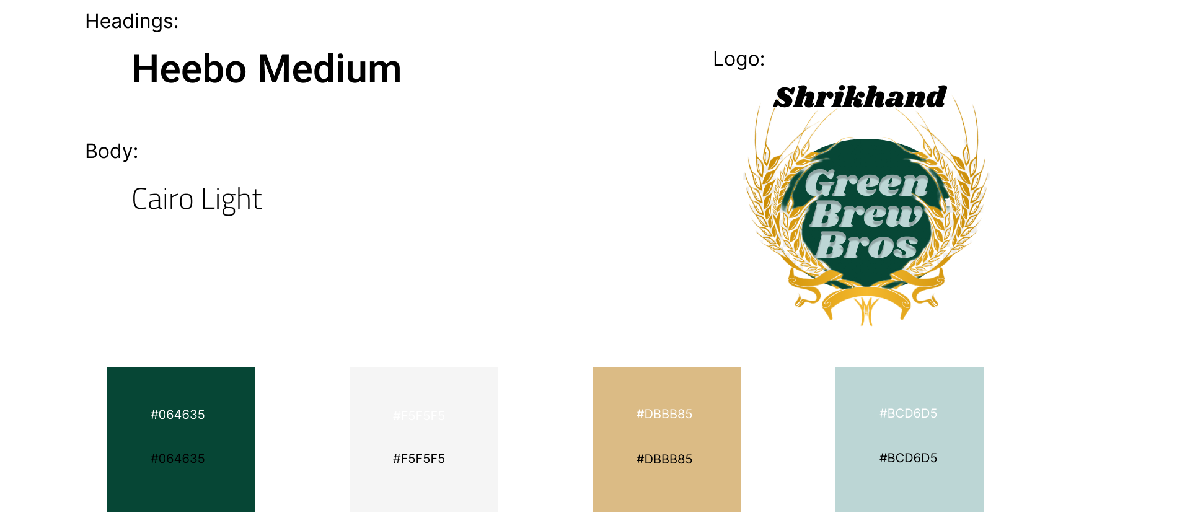
Colours and Fonts

Slide 9
Walkthrough

